Slide 1
Kate Isaacs
Website Content Mapping/Wireframes
July 2017

Slide 2
Phase 1 recommendations reflected in the following pages
Future recommended additions:
Additional tabs for resources/recommended sources and content, and affiliations
C-level quotes on value of the work or testimonials
More icons linking to social media, Twitter
Brief case studies/client stories
Email/newsletter sign-up to build email list
Speaking page, including a video of Kate presenting to an audience on her work
6-page PPT deck – why companies need a stakeholder strategy/evidence

Slide 3
HIGH-LEVEL NAVIGATION
Recommended Headers
Contact
Search
HOME
MEET KATE
CONSULTING
WRITING
CONTACT
Alternate Headers
HOME
ABOUT
BIO
WORK
PRACTICE
INSIGHTS
THINKING
BLOG
CONNECT
NOTE: Depending on the website template, it would be nice to feature a few of your favorite photos throughout the site. I would collect a few images you’ve taken and ask the web designer for recommendations of how they could be used.

Slide 4
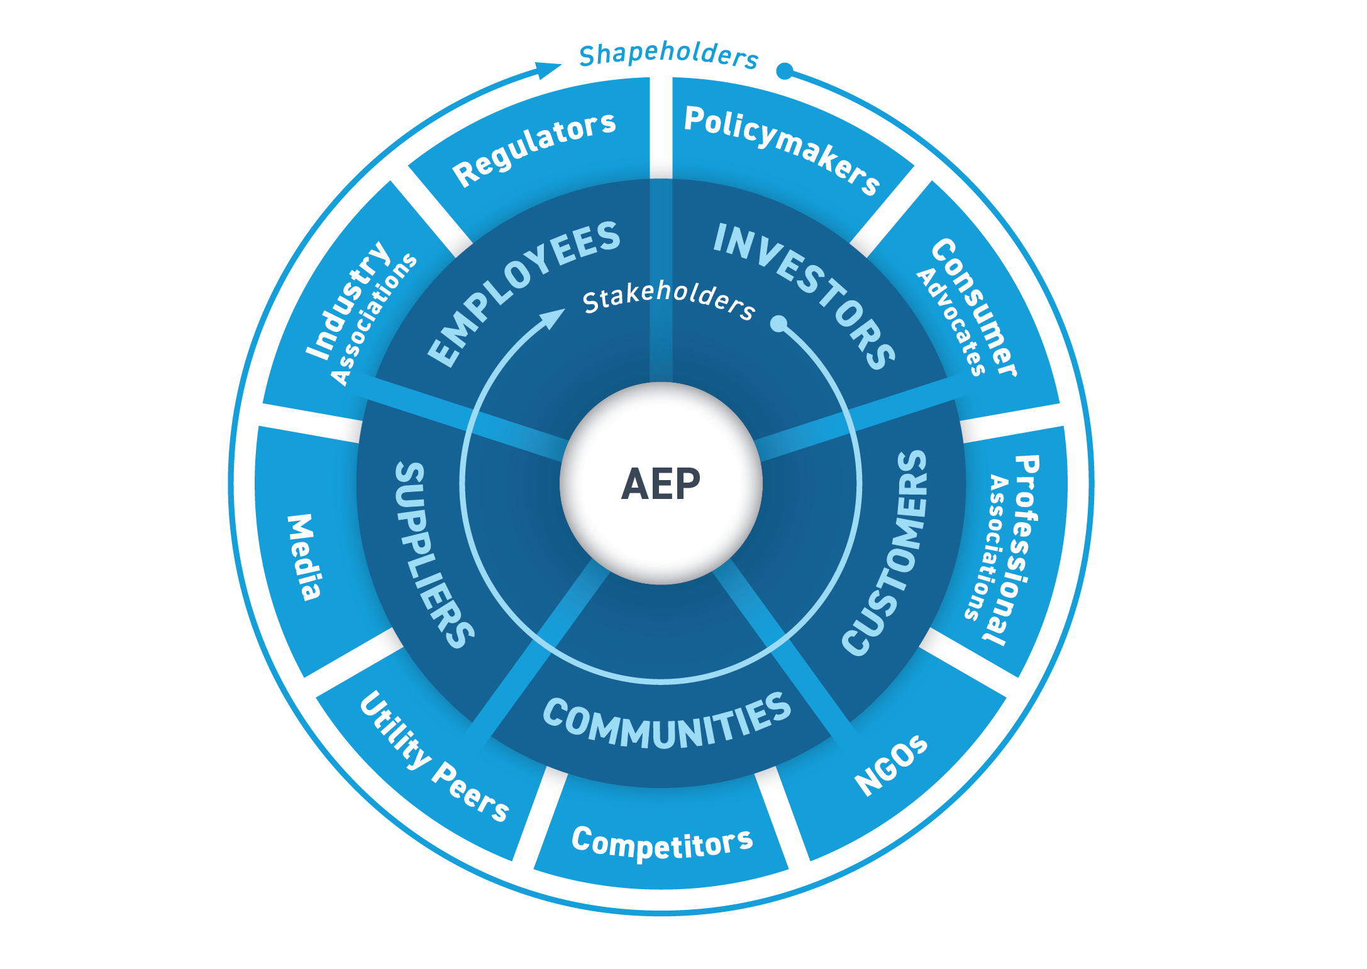
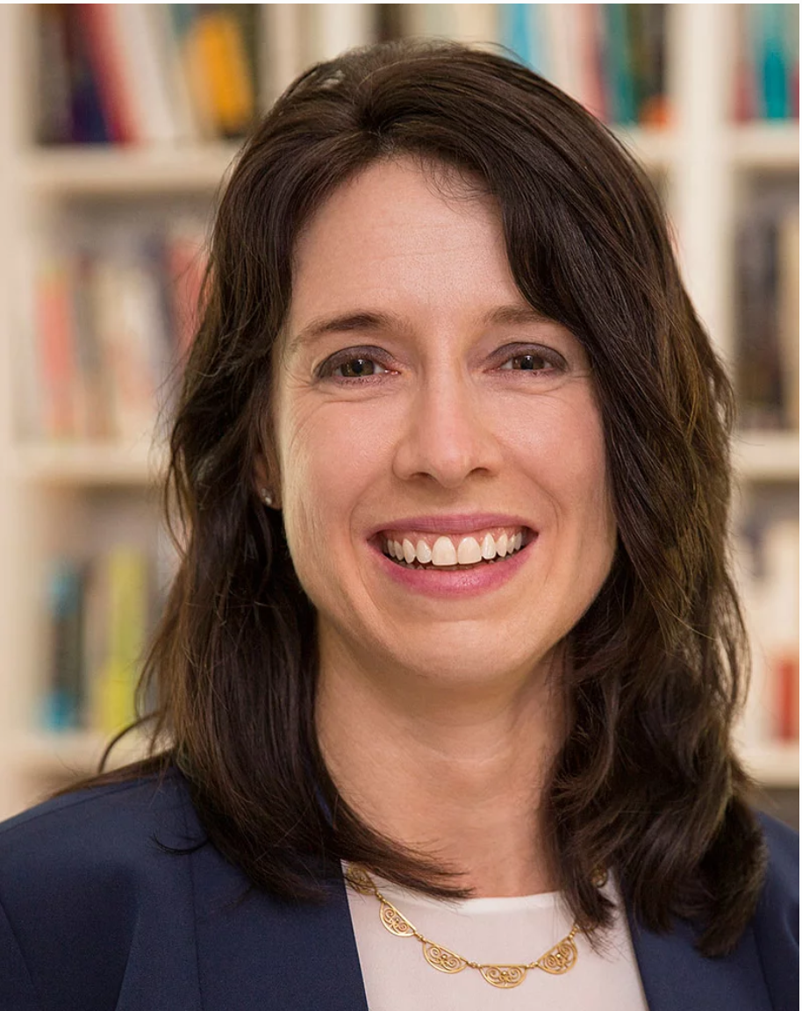
HOME PAGE
It’s a partnership economy.
Companies need to do more than maintain relationships with each of their stakeholder groups. They need to harness the power of engaging with them as a dynamic, integrated ecosystem.
This is how organizations will create real value and build long-term sustainable organizations.
Stakeholder Ecosystem
ORG
Learn More
Dr. Kate Isaacs - Consultant, researcher, facilitator. Expert on stakeholder engagement for values-driven organizations.
Kate Isaacs helps companies design and optimize their stakeholder strategy to enhance customer and employee engagement and create the conditions for innovation and collective social impact.
Meet Kate

Slide 5

HOME PAGE, CONT.
Want to build a stakeholder system that will create long-term value at your organization?
[IMAGE]
FEATURED ARTICLE
Chief Executive
Why CEOs Are Pushing for Community Prosperity
[First few lines of the piece, then link]
https://chiefexecutive.net/ceos-pushing-community-prosperity/
[For phase 2, I would add a newsletter signup here]

Slide 6

MEET KATE/ABOUT
Dr. Kate Isaacs has studied companies and advised executives on leadership, corporate citizenship, sustainability, and systems change for nearly 20 years.
She advises corporate clients on the design and effectiveness of their stakeholder engagement strategy. Her consulting is aimed at helping clients build in stronger interactions and connections that will generate collective long-term value for organizations across their complete stakeholder ecosystem.
Isaacs holds a research appointment at the MIT Sloan Leadership Center. She was previously research director for the Center for Higher Ambition Leadership, and continues in an advisory capacity. She also consults with clients through Dialogos, a management consulting and leadership development firm in Cambridge, MA.
She writes regularly for many leading publications including the Academy of Management journals, Harvard Business Review, Forbes and Chief Executive.
Isaacs earned a PhD in Organization Studies from the MIT Sloan School of Management, an M.S. degree in Technology and Policy from the MIT Engineering Systems Division, an M.S. degree in Conscious Evolution from the Graduate Institute, and a B.S. in Biology from the Oakland University Honors College. She is also a trained Shadow Work facilitator and coach.
Isaacs lives in Concord, Massachusetts with her family, and loves running, biking, yoga, skiing, and gardening. She also enjoys photography, and you’ll find some of her images on this site. She occasionally commutes to Colorado in the winter, where she finds no greater joy than telemark skiing in fresh Rocky Mountain powder.
Kate Isaacs
Contact Kate
Download CV

Slide 7
CONSULTING/WORK
It’s a partnership economy.
There is power in optimizing your stakeholder ecosystem operates.
Once you see how the whole system works together, you can create initiatives and make decisions that put the “flywheel” of positive stakeholder synergies in motion. This yields high-trust, mutual value creation and exponential results.
Stakeholder Ecosystem “Flywheel”
ORG
Outcomes:
More aligned purpose, strategy, leadership, culture, and execution
Loyal, long-term customers and partners
Inspired and engaged employees
Greater innovation and growth
Contribution to society
Stronger financial returns over the long-term

Slide 8

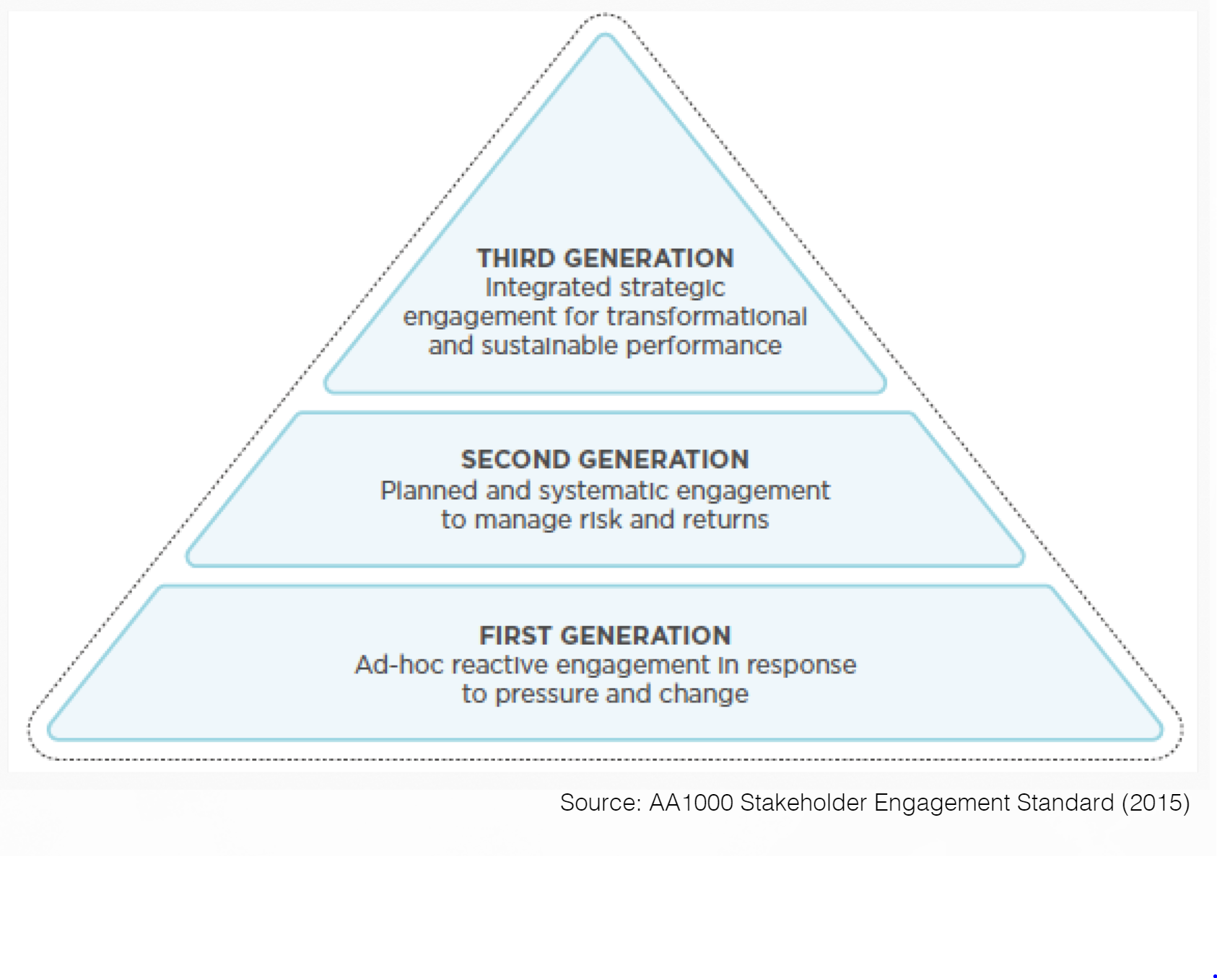
CONSULTING/WORK, CONT.
Experience
Kate brings expertise and tools from fields including organizational development, team dynamics, developmental psychology, leadership, and system dynamics modeling.
Here are snapshots of a few of her recent projects.
[IMAGE]
[IMAGE]
Partnered with a traditional energy company to xxxxxxxxxx
Client snapshot #2
Client snapshot #3
Stakeholder Engagement Pyramid
Where is your company now?
Where do you want to be?
Request An Exploratory Call

Slide 9
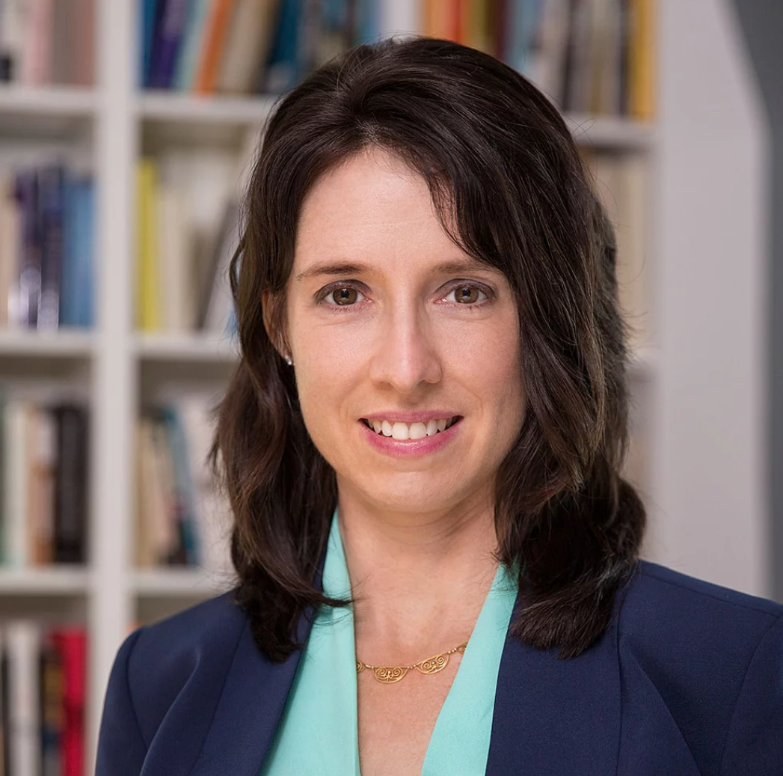
CONSULTING/WORK, CONT.
Clients
Kate consults primarily with corporate clients based in the U.S. She works directly with CEOS and members of their executive teams who lead key functions.
Companies are most successful with this work when they are high-trust, relationship-driven organizations with a long-term orientation and guided by a set of core values. Most clients have some ESG and CSR initiatives in place.
Strategy | Customer Engagement | ESG | CSR
Employee Relations | Culture | R&D | Sustainability
[Add row of client logos here when you can]
Consulting Services
Stakeholder Audits, Mapping, & Assessments
Stakeholder
Engagement Strategy &
Design
Partnership & Execution Guidance
Learn about Kate’s experience
Read Kate’s writing on sustainability, customer centricity and stakeholder system strategy.

Slide 10

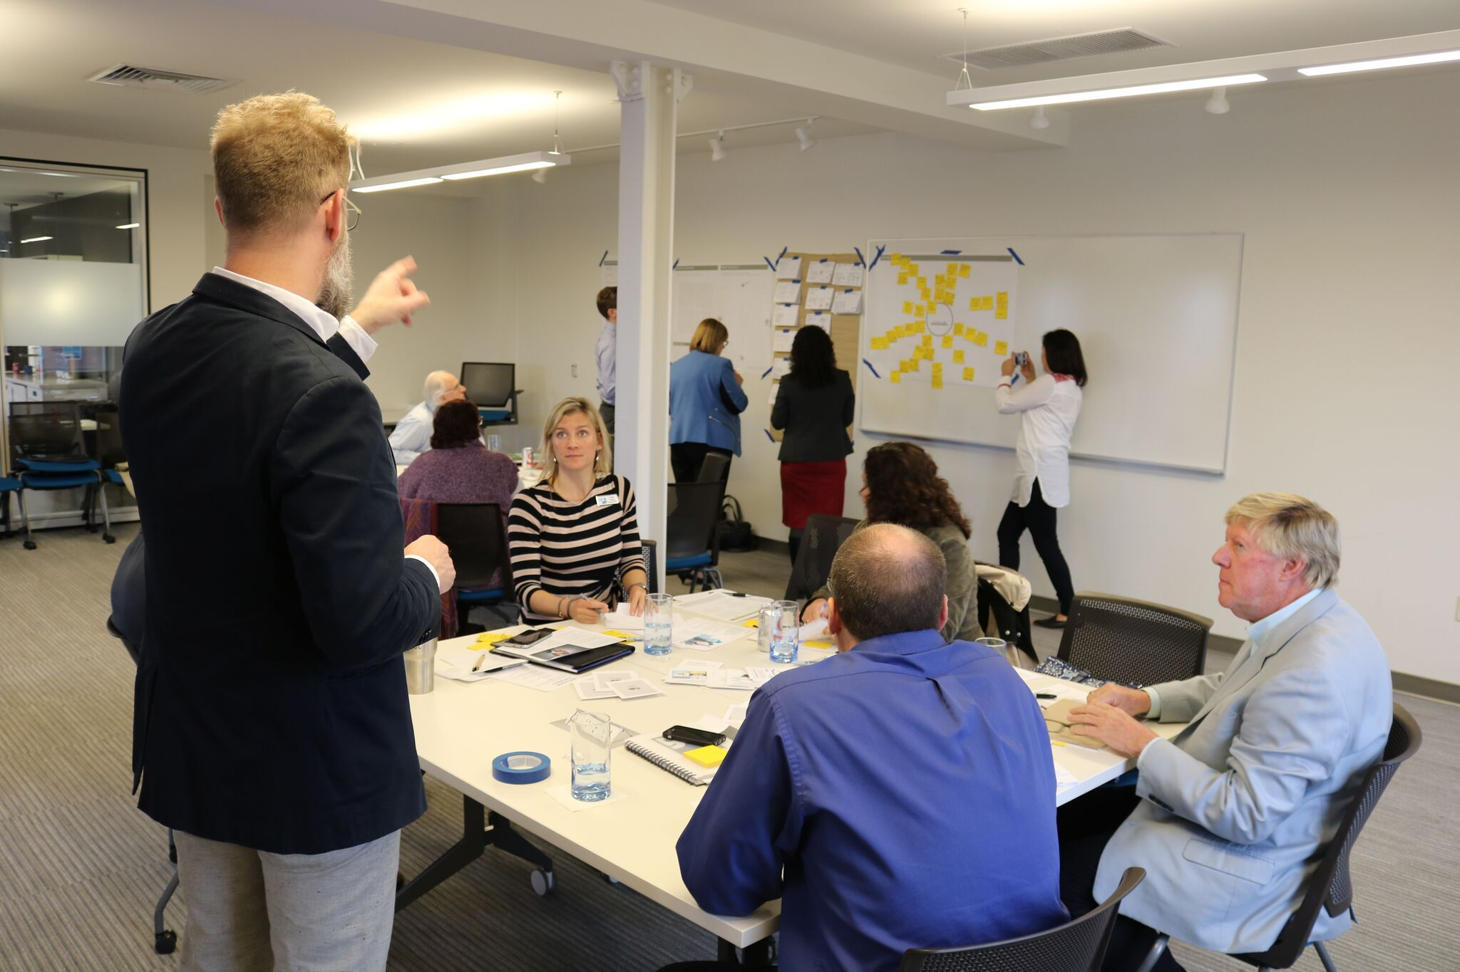
WRITING
[IMAGE]
FEATURED ARTICLE
Chief Executive
Why CEOs Are Pushing for Community Prosperity
[First few lines of the piece, then link]
https://chiefexecutive.net/ceos-pushing-community-prosperity/
PUBLISHED WRITING
[IMAGE]
[IMAGE]
[IMAGE]
CEOs Transcend Politics and Transform Social Problems: Michigan’s Talent 2025
Triple Pundit
Title, Publication
Title, Publication
SEE ALL ARTICLES
BLOG
[IMAGE]
[IMAGE]
[IMAGE]
Title
Title
Title
SEE ALL BLOG POSTS

Slide 11
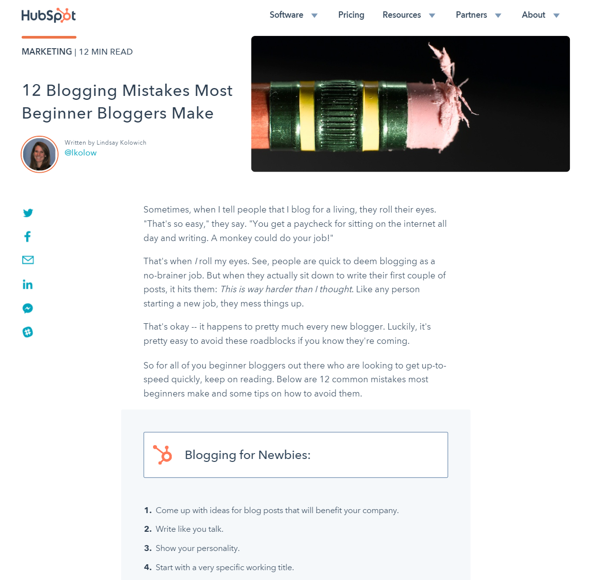
CONTENT SUB-PAGE FOR BLOG POSTS
https://blog.hubspot.com/marketing/beginner-blogger-mistakes

Slide 12

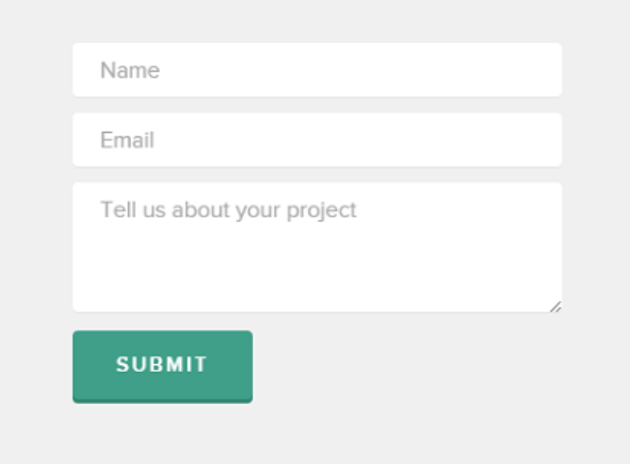

CONTACT
GET IN TOUCH
We are eager to discuss your business needs or answer any questions you have. Enter your details and we’ll get back to you shortly.
Or reach out directly
to Kate:
kisaacs@mit.edu
857-523-8234
Follow Kate

